Slide 1
Patterns of Reasoning
Minuk Valeria DA-92

Slide 2
PATTERNS OF REASONING
01
INDUCTIVE
02
TABLE OF CONTENTS
DEDUCTIVE
03
ABDUCTIVE
04
WHAT ARE PATTERNS OF REASONING

Slide 3
01
PATTERNS OF REASONING
You can enter here the sutitle if you need it

Slide 4
One of the great benefits of studying arguments is that we can draw inspiration from patterns that have been noticed and explored by others. Instead of bushwhacking our way through the forest, we have a map to lead us to well-worn trails that take us where we need to go.
We can’t simply lift up the patterns that structure arguments in other disciplines and plop them down precisely into data science. There are big differences between a courtroom, a scientific dispute, a national policy debate, and the work that we do with data in a professional setting. Instead, it is possible to take insights from patterns in other fields and mold them to fit our needs.

Slide 5
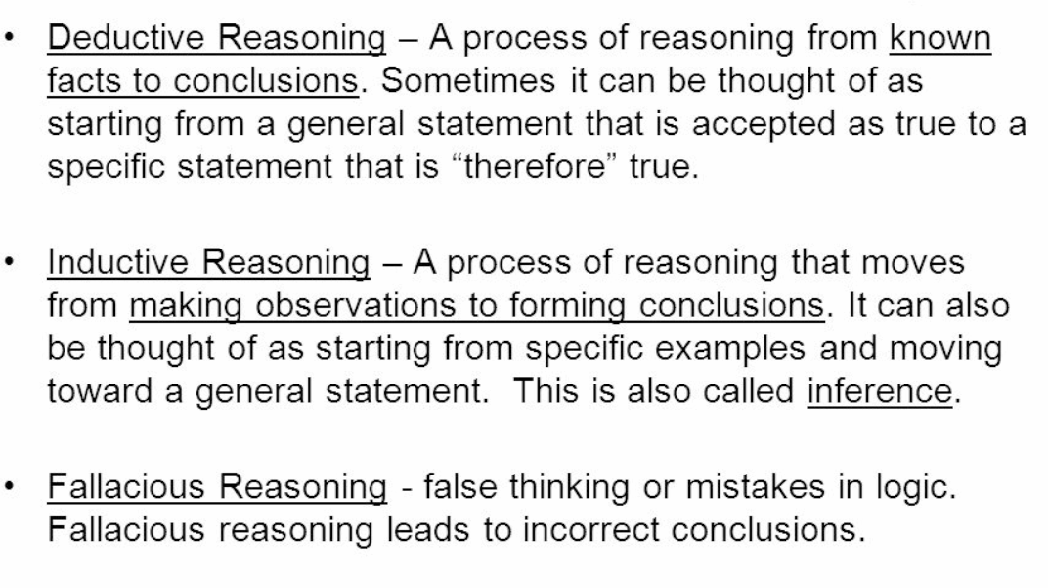
TYPES OF REASONING

Slide 6
02
INDUCTIVE
You can enter here the subtitle if you need it

Slide 7

.
INDUCTIVE REASONING
We have two basic approaches for how we come to believe something is true.
The first way is that we are exposed to several different examples of a situation, and from those examples, we conclude a general truth. For instance, you visit your local grocery store daily to pick up necessary items. You notice that on Friday, two weeks ago, all the clerks in the store were wearing football jerseys. Again, last Friday, the clerks wore their football jerseys. Today, also a Friday, they’re wearing them again. From just these observations, you can conclude that on all Fridays, these supermarket employees will wear football jerseys to support their local team.
This type of pattern recognition, leading to a conclusion, is known as inductive reasoning.

Slide 8
03
DEDUCTIVE

Slide 9
DEDUCTIVE REASONING
Knowledge can also move the opposite direction. Say that you read in the news about a tradition in a local grocery store, where employees wore football jerseys on Fridays to support the home team. This time, you’re starting from the overall rule, and you would expect individual evidence to support this rule. Each time you visited the store on a Friday, you would expect the employees to wear jerseys.
Such a case, of starting with the overall statement and then identifying examples that support it, is known as deductive reasoning.

Slide 10
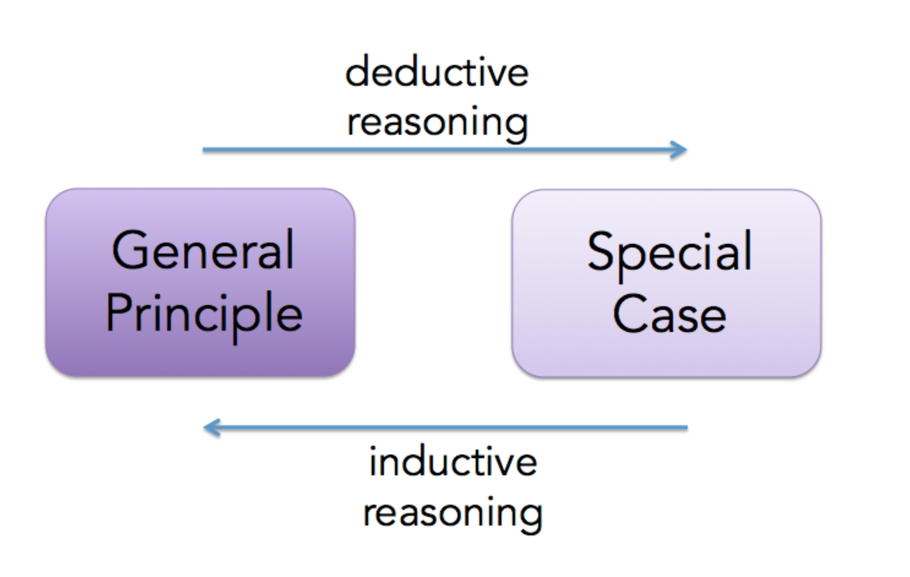
DIFFERENCE BETWEEN DEDUCTIVE AND ABDUCTIVE REASONING

Slide 11
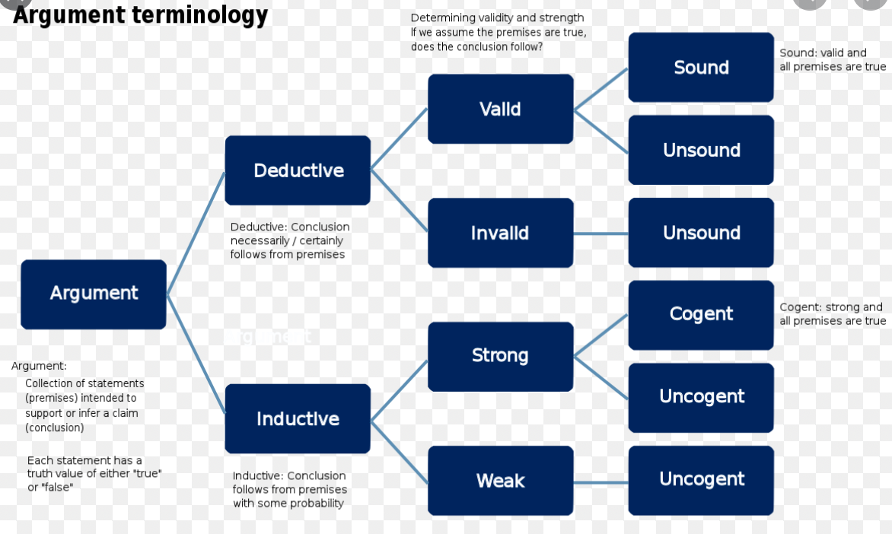
MORE AND MORE

Slide 12
04
ABDUCTIVE

Slide 13
ABDUCTIVE REASONING
Abductive reasoning is a form of logical inference formulated and advanced by American philosopher Charles Sanders Peirce beginning in the last third of the 19th century. It starts with an observation or set of observations and then seeks to find the simplest and most likely conclusion from the observations. This process, unlike deductive reasoning, yields a plausible conclusion but does not positively verify it. Abductive conclusions are thus qualified as having a remnant of uncertainty or doubt, which is expressed in retreat terms such as "best available" or "most likely". One can understand abductive reasoning as inference to the best explanation,although not all usages of the terms abduction and inference to the best explanation are exactly equivalent

Slide 14
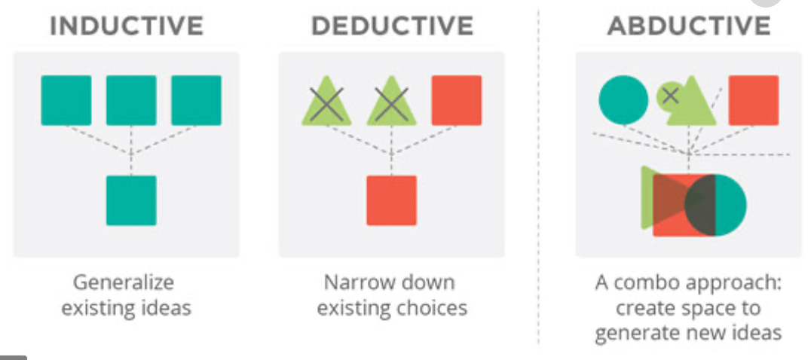
DIFFERENCE BETWEEN THEM ALL

Slide 15
THANKS
Does anyone have any questions?
addyourmail@freepik.com
+91 620 421 838
yourcompany.com

